Slide 1
Systematic Literature Reviews: i330 seminar
Nick Kirk

Slide 2
Seminar overview
Today we will cover:
Systematic Literature Reviews – what are they?
Uses of Systematic Literature Reviews
8 step process for completing a Systematic Literature Review

Slide 3
Systematic Literature Reviews – what are they?
Systematic Literature Reviews (SLRs) use repeated analytical methods to collect and analyse primary research studies. SLRs are: syntheses of primary research studies that use (and describe) specific, explicit and therefore reproducible methodological strategies to identify, assemble, critically appraise and synthesise all relevant issues on a specific topic (Carney and Geddes, 2002)”.
Systematic Literature Reviews began in healthcare research, but have now been adopted as a method across a wide range of different disciplines and areas of interest.
Webster and Watson (2002) argue that a successful literature review is one that:
“creates a firm foundation for advancing knowledge. It facilitates theory development, closes areas where a plethora of research exists, and uncovers areas where research is needed.”

Slide 4
Examples of SLRs
In environmental research, the journal Environmental Evidence publishes SLRs on the impacts of human activity on the environment and the effectiveness of management interventions. Examples of SLRs published in Environmental Evidence include:
Brooks et al. (2013) – Assessing community-based conservation projects: A systematic review and multilevel analysis of attitudinal, behavioral, ecological, and economic outcomes.
Häkkilä et al. (2021) – Are small protected habitat patches within boreal production forests effective in conserving species richness, abundance and community composition? A systematic review.
Beckhanova et al. (2021) – Biochar’s effect on the ecosystem services provided by sandy-textured and contaminated sandy soils: a systematic review protocol.

Slide 5
Examples of SLRs
The journal Environmental Research Letters also publishes SLRs on a range of topics relevant for MWLR researchers. Examples of SLRs published in Environmental Research Letters include:
Deubelli and Mechler (2021) – Perspectives on transformational change in climate risk management and adaptation.
Scully et al. (2021) – Carbon intensity of corn ethanol in the United States: state of the science.
Galama and Scholtens (2021) – A meta-analysis of the relationship between companies’ greenhouse gas emissions and financial performance.
Garrett et al. (2021) – Have food supply chain policies improved forest conservation and rural livelihoods? A systematic review.

Slide 6
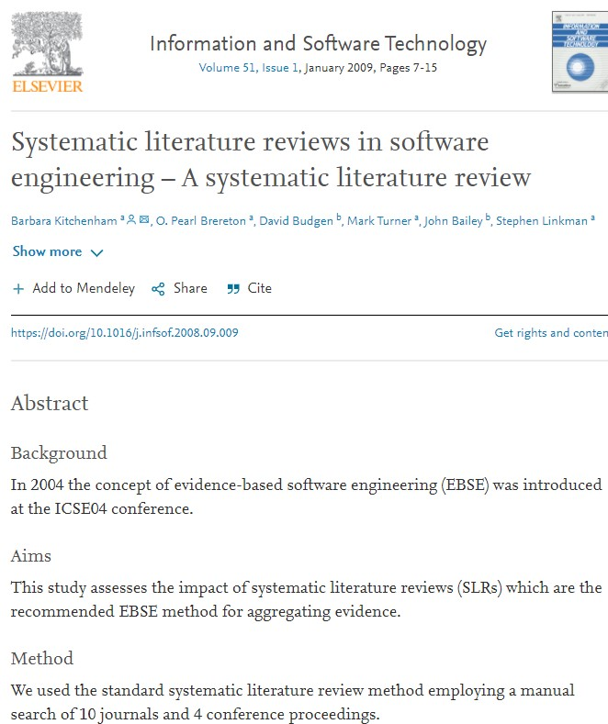
Examples of SLRs
There are even SLRs on SLRs! – Beckenham et al. (2009) Systematic literature reviews in software engineering – a systematic literature review.

Slide 7
Steps to complete SLR
1 – Develop your research question.
2 – Devise article screening criteria and SLR codebook.
3 – Develop a search chain.
4 – Select and search databases.
5 – Export searches to endnote or other similar software.
6 – Delete replications, search titles and abstracts for appropriate papers.
7 – Read remaining papers and delete those that are not relevant to the research question.
8 – Fill out SLR codebook.

Slide 8
Step 1 – Develop your research question
SLRs are designed to answer a clearly formulated question. The typical permutation of a reviewable question is: “Does intervention x on subject y produce outcome z?”
In one project, we recently conducted an SLR to collect empirical examples of land use change as an adaptation response. Our question: Are there empirical examples of agricultural land use change as an adaptation response?
Intervention = agricultural land use change
Subject = farmers
Outcome = agricultural land use change as an adaptation response
The goal in asking this question is to assess how interactions of values, rules, and knowledge(s) enable or constrain adaptation options available to farmers.

Slide 9
Step 2 - Devise article screening criteria and SLR codebook.
Inclusion | Exclusion
English | Non-English
Published between 1 January 2005 – 1 May 2020 | Pre-2005
Indexed in ISI Web of Science | Not indexed in ISI Web of Science
Peer-reviewed journal papers | Other type of publication (e.g. conference proceeding, book, report)
New land uses or changes to existing land use detailed in paper | No change in land use
Agricultural land use change | Non-agricultural land use change (e.g. tree planting, urban sprawl)
Papers’ detail deliberate change | Papers’ detail non-deliberate spontaneous change
Analysis of human systems (e.g. institutions) | Analysis of non-human systems (e.g. biological)
Papers’ detail empirical case studies | Papers do not detail empirical case studies (e.g. theoretical or modeled examples)
Papers’ detail empirical case studies of deliberate agricultural land use change in a developed nation (UNFCC Annex 1) | Papers detail case studies not from a developed nation
Table 2 Art

Slide 10
Step 2 - Devise article screening criteria and SLR codebook.
A codebook (or SLR protocol) contains a list of data you intend to collect from each paper that passes through the screening criteria. This typically includes things like the title, authors, author affiliations, and abstracts. It could also include the methods used in the research, type of data they collect and analyse, etc.
There are a range of different approaches to codebooks in SLRs.
PRISMA statement – the standard method for collecting and reporting data in an SLR. Used by papers in Environmental Research Letters.
ROSES – used by papers in Environmental Evidence.
STARLITE statement – qualitative systematic reviews in health research.
MOOSE checklist – meta-analyses for epidemiology.
STROBE statement – SLR reporting for epidemiology.
CONSORT statement – SLR reporting for comparison of clinical trials.

Slide 11
Step 3 – Develop a search chain
Various search chains are often developed and tested before the final search is confirmed.
Use wildcard and truncation symbols when possible.
(?) is useful for retrieving alternate spelling and simple plurals (wom?n will find woman or women).
(*) is useful for finding different word endings based on the root of a word (teen* will find teen, teens, teenager, teenagers).
(“ “) is useful for finding exact phrases (“electronic cigarettes” will find exact uses of electronic cigarettes. These exact phrases can be linked with AND or NOT).
Chain 1 – Land use* chang* adapt* agricultur*
Chain 2 – “land use*” AND “chang*” AND “adapt*” AND “agriculture*”

Slide 12
Step 4 – Select and search databases
Best practice to search multiple databases (e.g. ISI Web of Science, Scopus, Google Scholar, JSTOR, ResearchGate).
However, some recently published SLRs have justified the use of ISI Web of Science as the sole database (see Prober et al. 2017; Owen 2020).
In our practical example, the search was conducted using ISI Web of Science. This database is accessible through MWLR Library and Information Services.
The two search chains, deployed through ISI Web of Science, yielded a total of 3898 citations.

Slide 13
Step 5 - Export searches to endnote or other citation/abstract library
Why do this?
1) Ease of access and control,
2) Offline storage,
3) Ability to quickly delete any replicable citations,
4) Ability to select and delete publication types (e.g. conference proceedings, book sections, books, etc.).

Slide 14
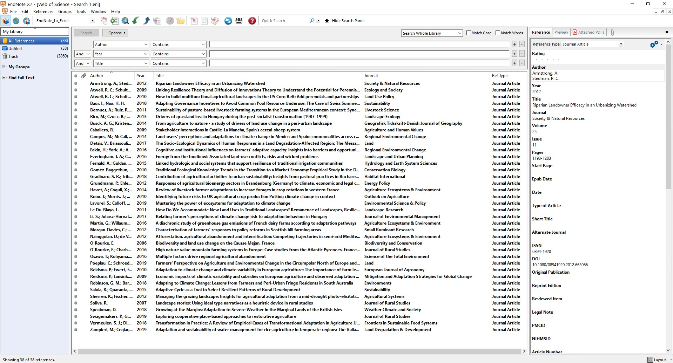

Slide 15
Step 6 - Delete replications, search titles and abstracts for appropriate papers.
Replicated citations can be easily removed in Endnote. Of the original 3898 citations found from our search, 1610 of these were duplicates which were deleted.
After duplicate citation deletion, researchers then scan the titles and abstracts of the remaining citations, using the screening criteria established in step 2 to decide what papers should be included and what should be excluded.
From this process, we decided to exclude a further 2262 citations from the search, leaving 62 potentially relevant studies.

Slide 16
Step 7 – Read remaining papers and delete those that are not relevant to the research question
After the title and abstract scan, all remaining papers should be closely reviewed to see if they meet the inclusion criteria.
In our example case, the remaining 62 citations were split between two researchers. Each read 31 papers and decided whether the individual citations needed to be included, excluded, or if they remained on the fence.
Following this, the researchers agreed to include 33 citations, exclude 15, and remained unable to agree on the final 14.
Both researchers then read the 14 final citations, and once this was done the researchers agreed to add 5 to the final SLR.
This resulted in 38 citations being selected, synthesised from an initial search which yielded 3898 citations.

Slide 17
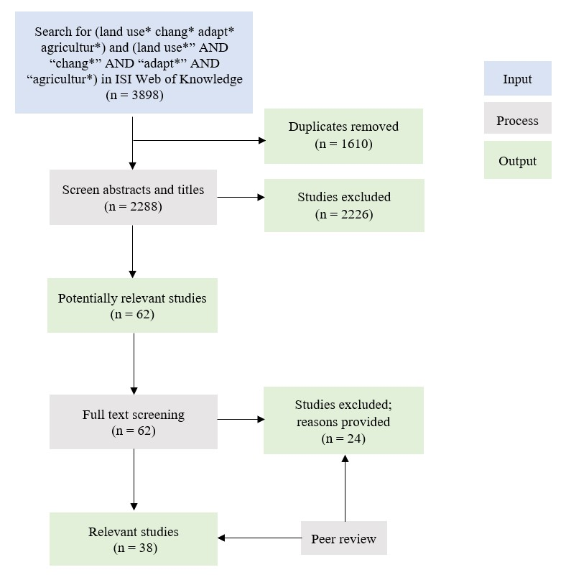

Slide 18
Step 8 – Fill in SLR codebook/protocol
The final step is to read through the selected papers and to collect data to be included in the codebook/protocol.
The data that is collected will depend on the reporting guidelines you have chosen (e.g. PRISMA, ROSES, etc.).
To publish SLRs, devising a codebook and following the reporting guidelines closely is very important. If the goal is simply to scope literature for a large project, such attention to detail might not be necessary.
Once this is complete, contemplate an analysis strategy. For example, SLRs that collect scientific results on similar studies could be analysed through a meta-analyses. SLRs could also be analysed qualitatively using thematic analysis or similar methods.

Slide 19
Summary
SLRs are published in a wide range of topics relevant to MWLR researchers: for example, climate change adaptation and mitigation, conservation, soil science, biodiversity and biosecurity, economics, and land management.
Choose a particular codebook strategy (e.g. PRISMA, ROSES) to align with journal requirements.
Spend time developing the best search chain and search multiple databases if possible.
Asking multiple researchers to screen collected papers reduces the chance of bias in paper selection.
Analytic methods – such as meta-analyses or qualitative data analysis – can be selected once the search is completed. However, it is worth considering how you plan to analyse the data before beginning the search.

Slide 20
Questions and feedback?
Feel free to email Nick Kirk (kirkn@landcareresearch.co.nz) or Melissa Robson-Williams (robson-williamsm@landcareresearch.co.nz) your feedback on this presentation.
Was the content useful?
Would you be confident to use systematic literature reviews now?
In terms of presentation format – one thing that worked ok?
In terms of presentation formation – one thing that you’d like to change?

Slide 21
References
Owen, G. 2020. What makes climate change adaptation effective? A systematic review of the literature. Global Environmental Change 62:102071.
Prober, S.M., Colloff, M.J., Abel, N., Crimp, S., Doherty, M.D., Dunlop, M., Eldridge, D.J., Gorddard, R., Lavorel, S., Metcalfe, D.J., Murphy, H.T., Ryan, P., Williams, K.J., 2017. Informing climate adaptation pathways in multi-use woodland landscapes using the values-rules-knowledge framework. Agriculture, Ecosystems & Environment 241, 39–53.

